Slide 1
Intro to ASP.NET Core
Daniel Roth
Senior Program Manager

Slide 2
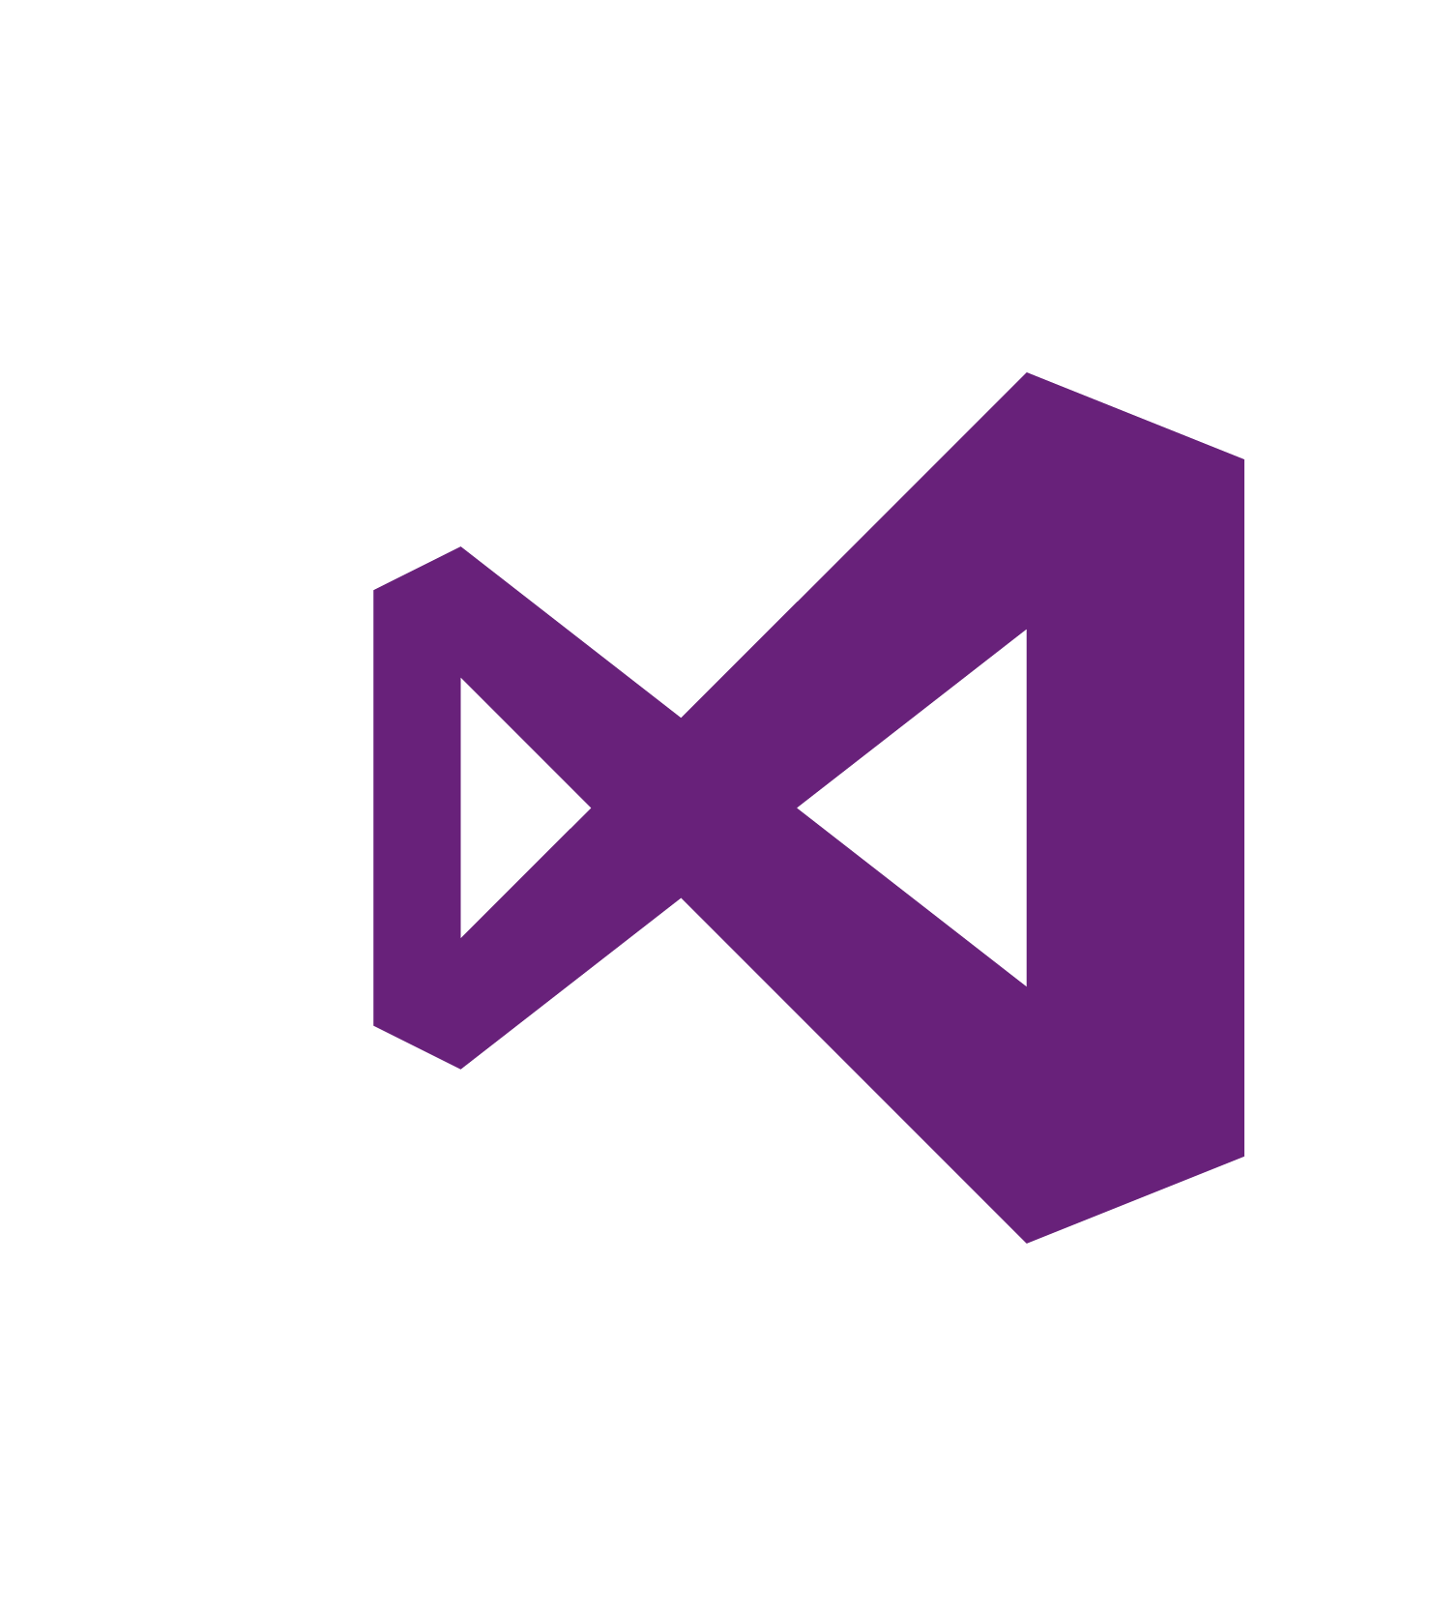
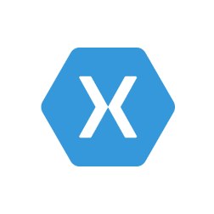
.NET – a unified platform
.NET FRAMEWORK
WINDOWS APPLICATIONS
CROSS-PLATFORM SERVICES
XAMARIN
.NET CORE
MOBILE APPLICATIONS
TOOLS
Visual Studio
.NET STANDARD LIBRARY
Visual Studio Code
COMMON INFRASTRUCTURE
Xamarin Studio
Compilers
Languages
Runtime components

Slide 3
61%
YoY Growth .NET Active Developers
(VS 2012+)
40%
.NET Core downloads by new developers
62% GitHub contributions from outside of Microsoft
(corefx / coreclr repos)

Slide 4
ASP.NET Core (previously ASP.NET 5)
A new open-source and cross-platform framework for building modern cloud-based Web applications using .NET

Slide 5


ASP.NET Core and the Modern Web
Totally Modular
Faster Development Cycle
Seamless transition from on-premises to cloud
Choose your Editors
and Tools
Open Source with Contributions
OSS
Cross-Platform
Fast

Slide 6
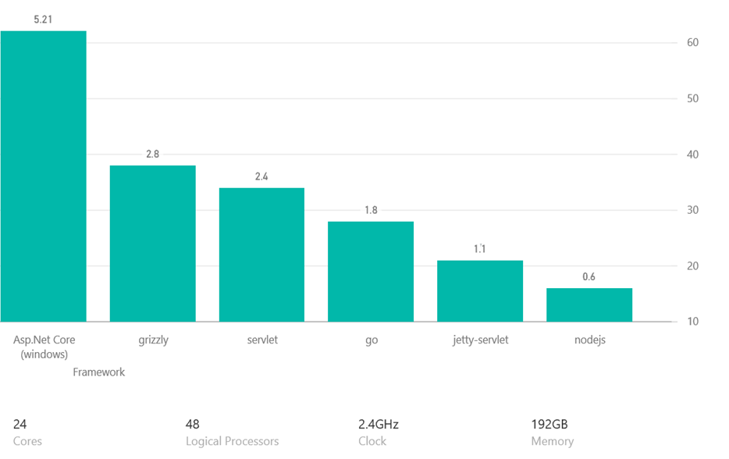
TechEmpower – Top 10 Frameworks - PlainText

Slide 7
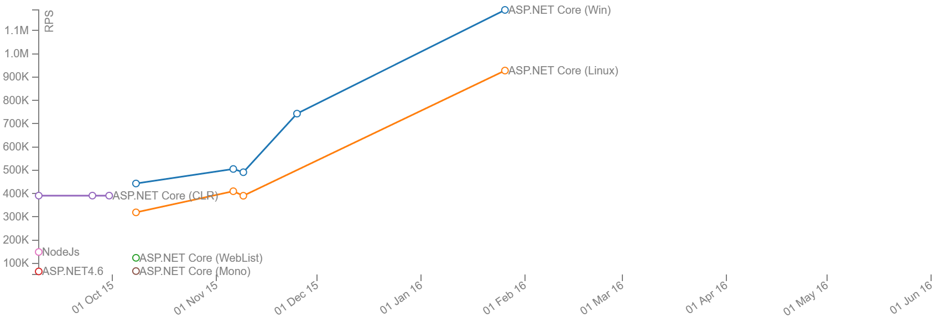
Age of Ascent Benchmarks
http://web.ageofascent.com/asp-net-core-exeeds-1-15-million-requests-12-6-gbps/
ASP.NET 4.6
ASP.NET Core
on CoreCLR

Slide 8



ASP.NET Core in a Nutshell
Web
Forms
MVC
Web API
ASP.NET Core MVC
ASP.NET 4.6
(System.Web)
ASP.NET Core 1.0
(Microsoft.AspNetCore)
.NET Framework
.NET Core
Platform for .NET applications on Windows
Cross-platform, modular libraries & runtime optimized for server and cloud workloads

Slide 9
ASP.NET Core features
Hosting
Kestrel, Startup
Middleware
Routing, authentication, static files, diagnostics, error handling, session, CORS, localization, custom
Dependency Injection
Configuration
Logging
Application frameworks
MVC, Identity, SignalR (future)

Slide 10
Getting Started with ASP.NET Core 1.0
Go to http://dot.net
Docs: https://docs.asp.net
Samples and code: https://github.com/aspnet

Slide 11
Code
Notes:
Getting Started with .NET Core
- Get the .NET Core SDK/Tooling from https://dot.net
- dotnet new
- Show generated code in VSCode
- dotnet restore
- Talk to NuGet feeds and packages
- Show where packages get restored
- dotnet restore -v Information
- dotnet run (does a build)
- Show built output
Getting Started with ASP.NET Core
- https://asp.net/get-started
- Restore packages in VSCode
- Run in VSCode
Host config and startup
- Create empty app in VS
- Content root
- IIS integration
- Show that you can set the server URL and port
Middleware
- Setup static files
- Default files (talk to ordering)
- Talk to exception handling page
Logging
- Add the Debug logger
- Show the logging output (console and debug)
Configuration
- Create new Web App w/auth
- Talk to provider model
MVC
- Template route syntax
- Web API action with attribute routing
- C# 6 support
- Add var me = "me"; $"About {me}";
- Async views, @await
- @inject
- Tag Helpers
- Compare login views
- Show editor intellisense for styles and bound attributes
- Built-in tag helpers: environment, script

Slide 12
Hosting in production
Kestrel is not yet hardened for internet facing traffic
Run Kestrel behind a mature reverse proxy
Ex IIS, Nginx, Apache, etc.
Proxy
Kestrel
Internet
Kestrel
Kestrel

Slide 13
Middleware
Middleware1
Middleware2
Middleware3
Request
// logic
next();
// logic
next();
// logic
// more logic
// more logic
// more logic
Response

Slide 14
Roadmap
1.1 - Q4 2016
URL rewriting
Response caching
Compression
WebListener server (Windows only)
Middleware as MVC filters
Precompiled views
View Components as Tag Helpers
Improved Azure integration
WebSockets
1.2 - Q2 2017
SignalR
Web API security
“Razor Pages” (views without MVC controllers)
ASP.NET Core “Modules”

Slide 15
Futures
Notes:
ASP.NET Core Modules

Slide 16
Join us!
Code: https://github.com/aspnet/home
Docs: http://docs.asp.net
Live: http://live.asp.net

